Slide 1
PYTHON DESIGN PATTERNS
Abstraction, Interface & Protocol in Python
Understanding ABC, Protocol, Duck Typing & Static Type Checking
A beginner-friendly guide to writing structured, flexible, and maintainable Python code.
[Your Name]

Slide 2





THE PROBLEM
What Are We Trying to Solve?
"How can we design Python code where different classes follow the same expected behavior?"
class UPI:
def pay(self, amount):
print("Paid using UPI")
class Card:
def pay(self, amount):
print("Paid using Card")
Both classes provide pay() — but how do we formally describe and enforce this relationship? Python offers several approaches:
Abstraction
Interface
ABC
Protocol
Duck Typing

Slide 3


CONCEPT 1
Abstraction
Abstraction means hiding unnecessary implementation details and exposing only the essential functionality.
Consider an ATM: you choose Withdraw, Deposit, or Check Balance — but you don't need to know how the bank server processes the transaction.
What you see
What's hidden
Withdraw · Deposit · Check Balance
Server logic, encryption, database queries
Key idea: The user knows what operation is available, not how it is implemented.
payment.pay(500)

Slide 4
CONCEPT 1 — IN PYTHON
Abstraction Using ABC
Python's abc module lets you define abstract base classes that enforce a contract on subclasses.
from abc import ABC, abstractmethod
class Payment(ABC):
@abstractmethod
def pay(self, amount):
pass
ABC
@abstractmethod
Payment
Creates an abstract base class that cannot be instantiated directly.
Defines a method that every subclass must implement.
Defines the required behavior; implementation is left to subclasses.

Slide 5
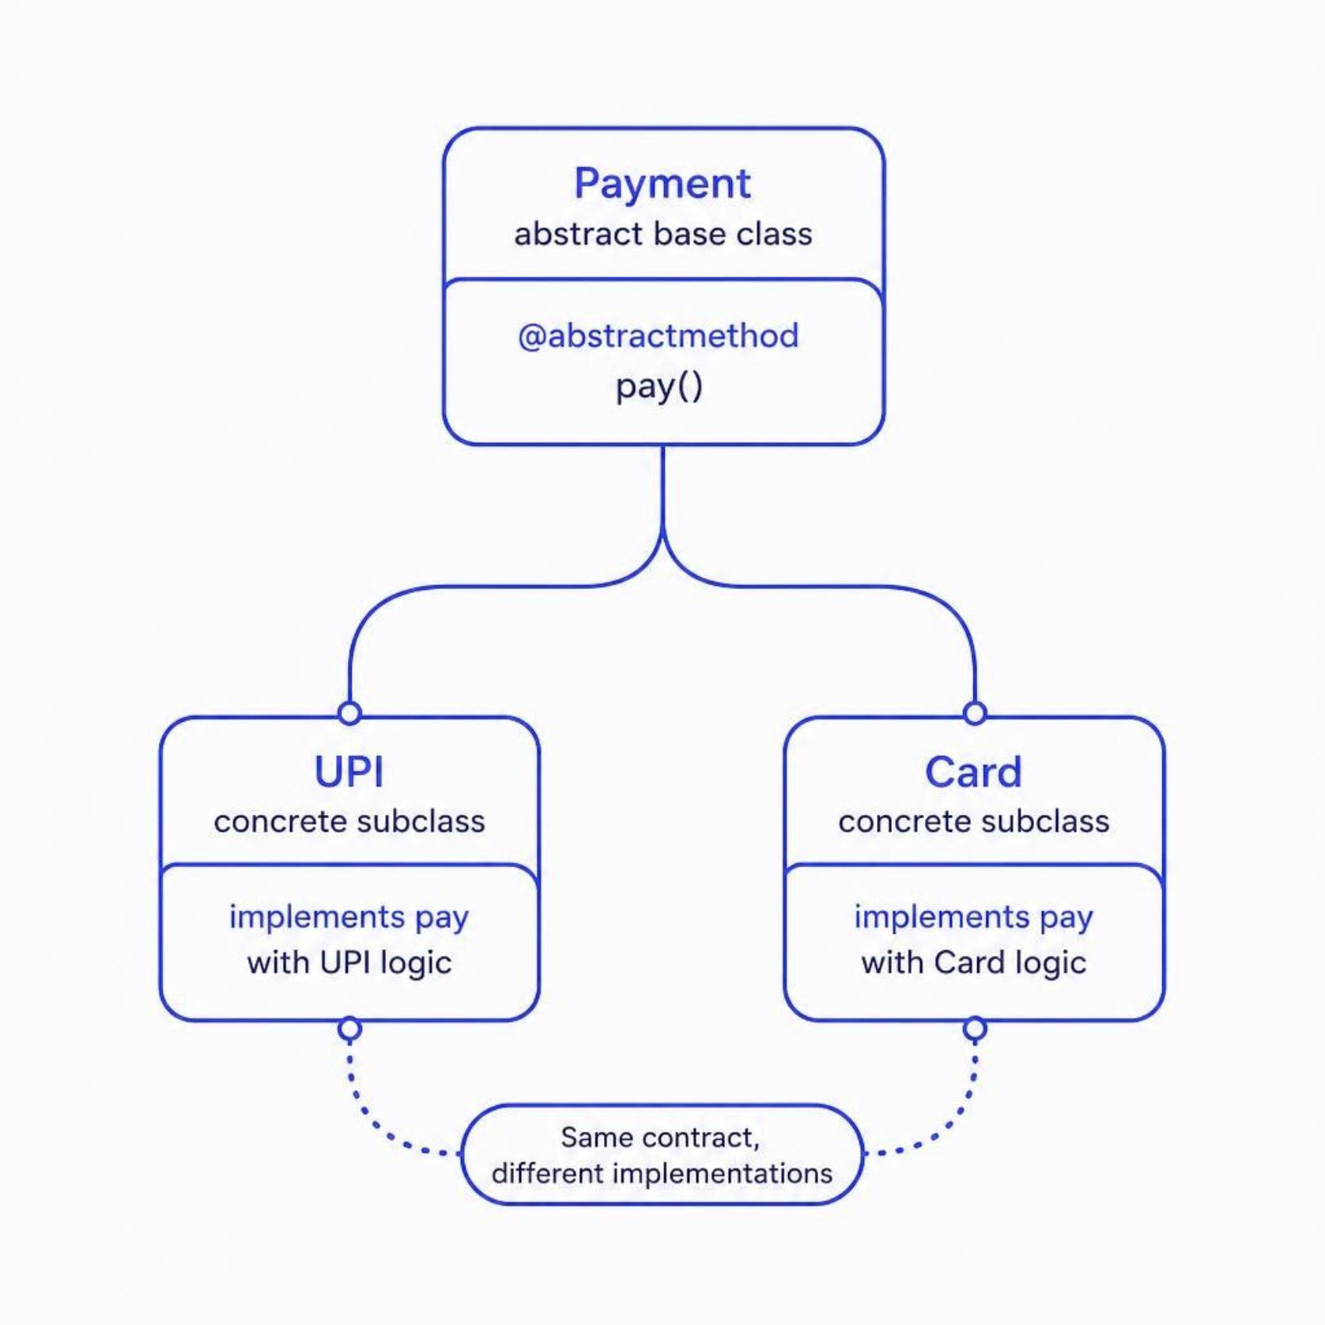
ABC IN ACTION
ABC Example: Same Contract, Different Implementations
class UPI(Payment):
def pay(self, amount):
print(f"Paid ₹{amount} via UPI")
class Card(Payment):
def pay(self, amount):
print(f"Paid ₹{amount} via Card")
Payment() cannot be instantiated while its abstract method remains unimplemented — Python enforces the contract.

Slide 6
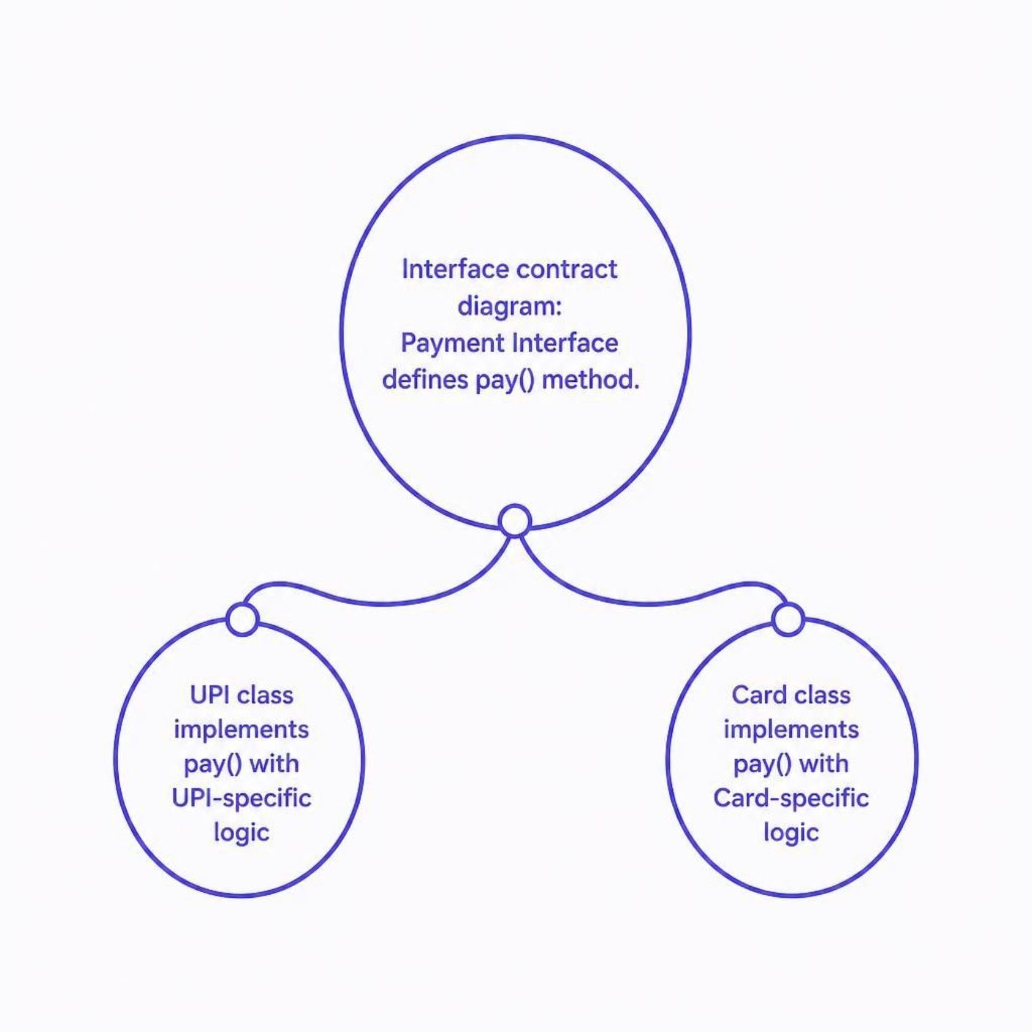
CONCEPT 2
What Is an Interface?
An interface is a contract that defines what operations a class should provide — not how they are performed.
Python does not have a dedicated interface keyword like Java or C#. Instead, Python models interface-like contracts using:
Abstract Base Classes — enforce implementation at runtime
Protocols — define structural compatibility (covered next)
Interface asks: "What should this object provide?"
Implementation answers: "How does this object perform it?"

Slide 7

CONCEPT 3
What Is a Protocol?
A Protocol defines an expected structure for an object — without requiring inheritance. It's Python's way of supporting structural subtyping.
from typing import Protocol
class Storage(Protocol):
def save(self, filename: str) -> None:
...
What Storage says
No inheritance required
"Any object that wants to behave like Storage must provide save() with the expected signature."
A class satisfies the Protocol simply by having the right methods — it never needs to explicitly inherit from Storage.

Slide 8
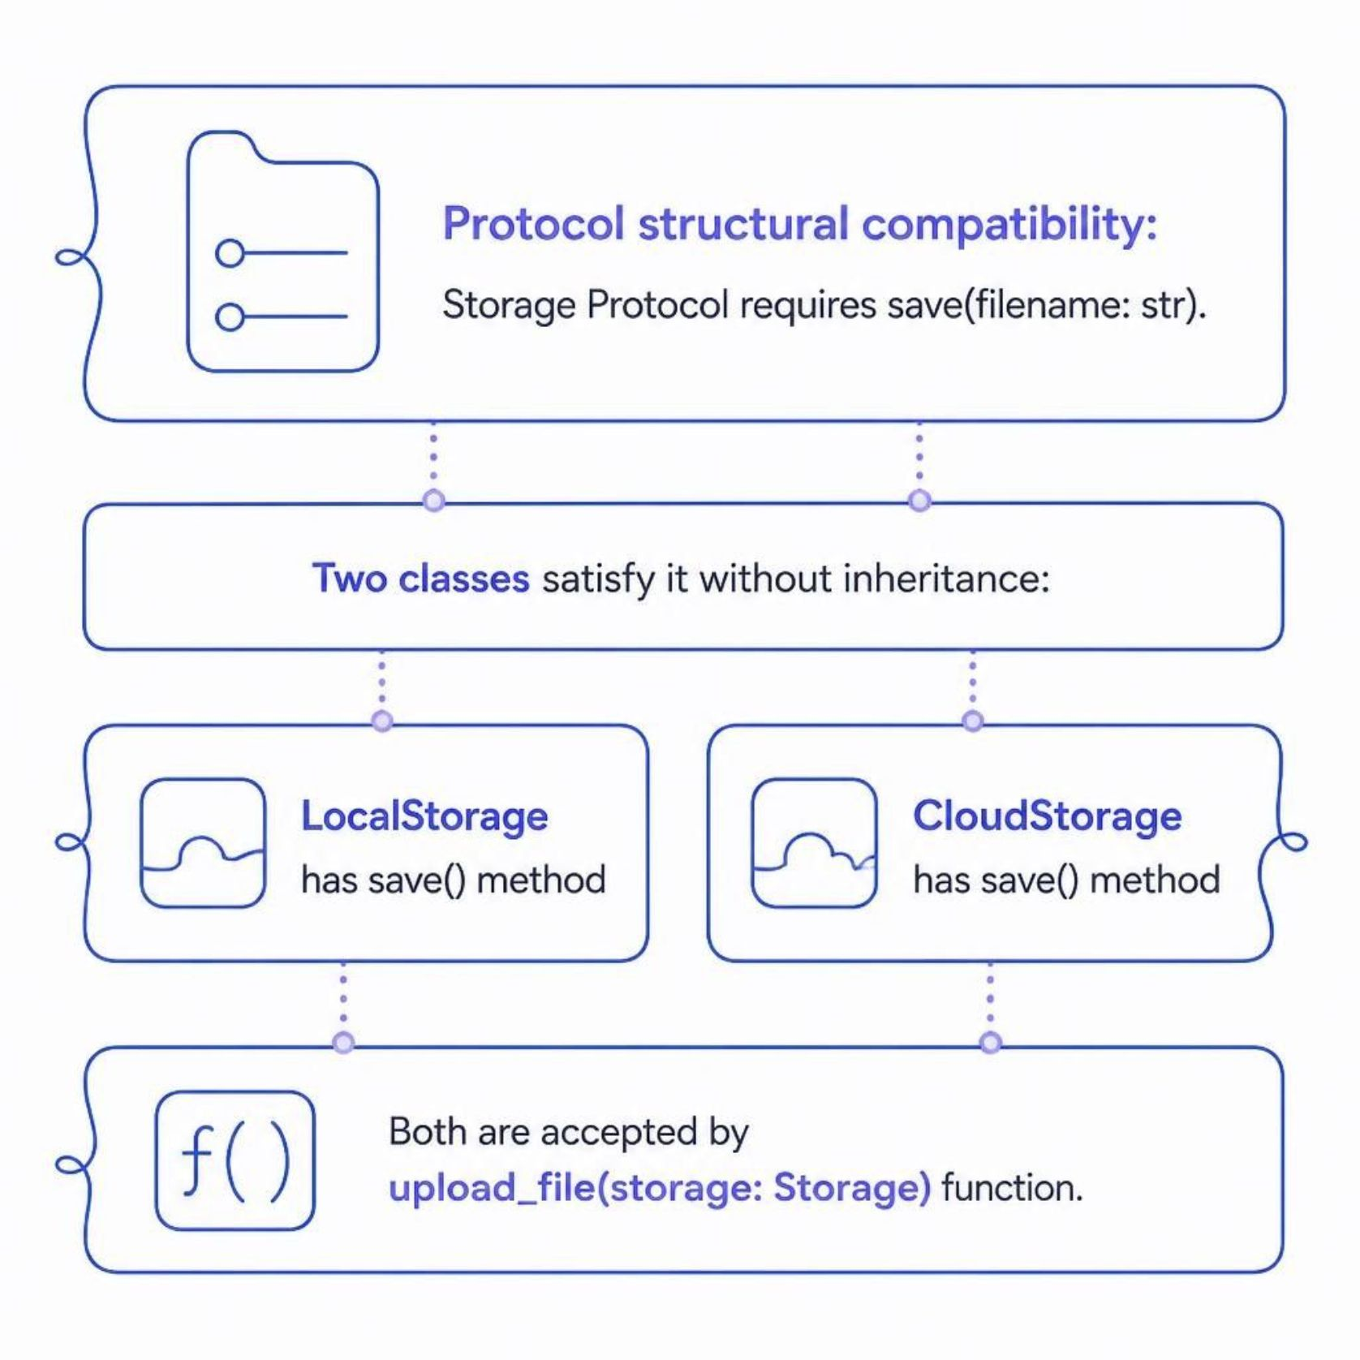
PROTOCOL IN ACTION
Protocol Example: Structural Compatibility
class LocalStorage:
def save(self, filename: str) -> None:
print(f"Saving {filename}")
class CloudStorage:
def save(self, filename: str) -> None:
print(f"Uploading {filename}")
def upload_file(storage: Storage):
storage.save("report.pdf")
upload_file(LocalStorage())
upload_file(CloudStorage())
Neither class inherits from Storage. They satisfy the Protocol structurally — by having the required method signature.

Slide 9
CONCEPT 4
Duck Typing & Static Type Checking
🦆 Duck Typing
🔍 Static Type Checking
"If it walks like a duck and quacks like a duck, it's a duck."
Python checks behavior at runtime — if an object has the required method, it works, regardless of its class hierarchy.
Tools like mypy analyze code before runtime using type hints, catching mismatches early.
def process(p: Payment):
p.pay(500)
process(UPI()) # ✓ mypy OK
process("hello") # ✗ mypy error
for obj in [UPI(), Card()]:
obj.pay(100) # Works!

Slide 10

SUMMARY
Key Takeaways
Abstraction
ABC
Hide complexity, expose essentials
Enforce contracts via inheritance
Interface
Protocol
Define what, not how
Structural compatibility, no inheritance needed
Duck Typing
Type Checking
Runtime behavior over class hierarchy
Catch errors before runtime with mypy
Remember: Use ABCs when you need enforced contracts, Protocols for flexible structural typing, and Duck Typing for Pythonic simplicity. Combine with static type checking for robust, maintainable code.

